Slide 1

Enhancing Performance Of Operating System Using Machine Learning
Project Members:
1. Lakshay Bansal (287/CO/12)
2. Ravish Mahur (339/CO/12)
3. Rishab Banerjee (340/CO/12)

Slide 2
ABSTRACT
There is no single scheduling or memory management algorithm that could provide good performance consistently under varying environment –Being affected by workload, file system, disk system…
Therefore, a new self learning approach is proposed which can adapt to various types of workloads, and make decisions for optimizing the performance of the OS.

Slide 3
Work Hitherto
Courses Done
Machine Learning (Dr. Andrew Ng, Stanford University)
Introduction To Data Science (Dr. Bill Howe, Washington University)
Artificial Intelligence(UC Berkeley)
R Programming (Dr. Roger Peng, John Hopkins )
Introduction To Linux (edX)
Research Papers
Self Learning Disk Scheduling (IEEE)
Applying Machine Learning Techniques to improve Linux Process Scheduling (IEEE)
To Collect Or Not to Collect? Machine Learning For Memory Management ()
Dynamic Multicore Resource Management: A Machine Learning Approach

Slide 4
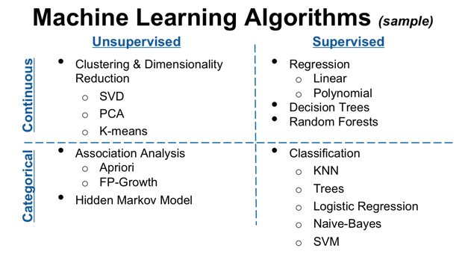
Machine Learning Techniques

Slide 5
Regression
Linear
Logical

Slide 6
Neural Networks

Slide 7
CLUSTERING
Support Vector Machines
K-Means

Slide 8
FOCUS AREAS
Optimize the performance of the following aspects of OS:
Process Scheduling
Memory Management
Disk Scheduling
Cache

Slide 9
PROCESS SCHEDULING

Slide 10
MEMORY MANAGEMENT

Slide 11
DISK SCHEDULING
Self-learning disk scheduling schemes
Change-Sensing Round-Robin Selection
Feedback Learning
Per-Request Disk I/O Scheduler
Two-Layer Combined Learning Scheduler (Best Performance) - It employs feedback learning techniques to analyze workloads, change scheduling policy, and tune scheduling parameters automatically. We discuss schemes to choose features for workload learning, divide and recognize workloads, generate training data, and integrate machine learning algorithms into the Two-layer Learning Scheme

Slide 12
Adaptive Replacement Cache
Algorithm
The self-tuning, low-overhead, scan-resistant adaptive replacement cache algorithm outperforms the least-recently-used algorithm by dynamically responding to changing access patterns and continually balancing between workload recency and frequency features
ARC maintains two LRU pages lists: L1 and L2.L1 maintains pages that have been seen only once, recently, while L2 maintains pages that have been seen at least twice, recently. Hence, we say that L1 captures recency, while L2 captures frequency.
ARC adapts quickly and effectively to a variable workload size. A real-life implementation revealed that ARC has a low space overhead—0.75 percent of the cache size. Also, unlike LRU, ARC is scanresistant in that it allows one-time sequential requests to pass through without polluting the cache or flushing pages that have temporal locality.
Likewise, ARC also effectively handles long periods of low temporal locality

Slide 13
Study Material/ Previous Establishments
1). Applying Machine Learning Techniques to improve Linux Process Scheduling
-Atul Negi, Senior Member, IEEE, Kishore Kumar P.

